Slide 1


WEATHER TREND FORECASTING
Exploring Past Patterns to Forecast the Future Through Statistical and Time Series Analysis
Page 1

Slide 2

PM ACCELERATOR
The PM Accelerator mission focuses on empowering data-driven decision-making and analytical excellence to solve real-world problems using structured methodologies and impactful insights.
This project embodies the PM Accelerator commitment to democratizing access to elite tools and AI skills, leveling the playing field for diverse talent. It fosters future leadership by connecting aspiring PMs with industry experts within a robust, growth-oriented ecosystem.
Times New Roman
Times New Roman
Times New Roman
Page 2

Slide 3

Introduction
Weather trend forecasting is essential for informed decision-making in sectors such as agriculture, urban planning, and disaster preparedness. Historical weather data enables the identification of long-term trends and recurring seasonal patterns. This project applies statistical and time series analysis techniques to model and forecast future weather behavior. The project aims to provide accurate, interpretable, and data-driven forecasts.
Page 3

Slide 4
Problem Statement
Climate variability and extreme weather events pose significant risks to agriculture, urban planning, and supply chains. Without accurate historical analysis and predictive capabilities, stakeholders struggle to make proactive, data-driven decisions regarding resource management and risk mitigation.
Objective
Analyze Historical Trends: To examine global weather patterns, identifying correlations between temperature, air quality, and other climatic factors.
Forecast Future Conditions: To develop predictive models that estimate future weather metrics, aiding in forward-looking strategy and planning.
Enable Data-Driven Decisions: To transform raw meteorological data into actionable insights that align with the PM Accelerator mission of solving real-world problems.
Page 4

Slide 5
Dataset Overview
Source & Scope
Data Source: Global Weather Repository (Comprehensive meteorological dataset).
Coverage: Multi-national dataset covering diverse geographical locations, capturing distinct climatic zones and seasonal variations.
Data Type: Structured tabular data combining geospatial information (Location, Latitude, Longitude) with time-series meteorological observations.
Relevance
Provides a holistic view of global climate health.
Enables comparative analysis across different regions and hemispheres.
Sufficiently granular to support both exploratory analysis and machine learning forecasting tasks.
Page 5

Slide 6
Data Description & Features
Key Features Analyzed
Geospatial: Country, Location Name, Latitude, Longitude (used for regional mapping and segmentation).
Atmospheric Conditions:
Temperature_Celsius / Fahrenheit: Primary metric for trend analysis.
Humidity: Crucial for understanding precipitation potential.
Wind Speed & Direction: Indicators for storm patterns and energy potential.
Air Quality Index (AQI): Metric for assessing environmental health and pollution levels.
Temporal :
Last Updated (Timestamp): Critical for time-series sequencing and seasonality extraction.
Page 6

Slide 7
Data Cleaning & Preprocessing
Data Integrity: Verified data types and eliminated duplicate entries to ensure analysis consistency.
Missing Values: Conducted null-value assessments and sanitized the dataset to maintain completeness.
Feature Engineering: Converted raw timestamps into DateTime objects, extracting Year, Month, and Day for seasonal trend analysis.
Outlier Management: Analyzed statistical distributions to validate extreme weather anomalies versus data errors.
Page 7

Slide 8
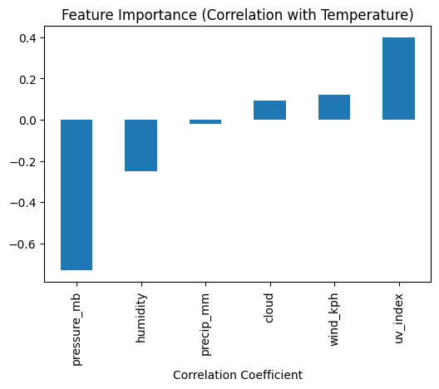
Exploratory Data Analysis (EDA)
Performed summary statistics to understand the distribution of key weather variables.
Analyzed data distributions, variability, and correlations among numerical features.
Visualized patterns using line plots, histograms, boxplots, and correlation heatmaps.
Identified anomalies, outliers, and data quality issues impacting forecasting accuracy.
Page 8

Slide 9
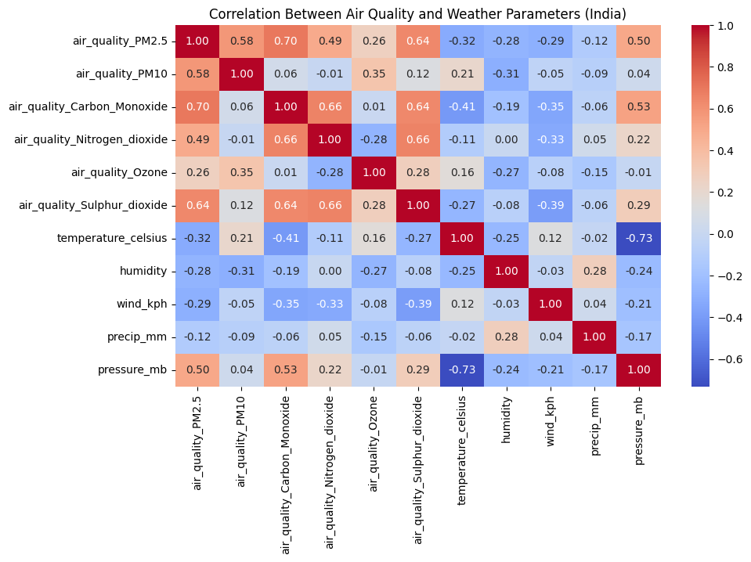

Slide 10
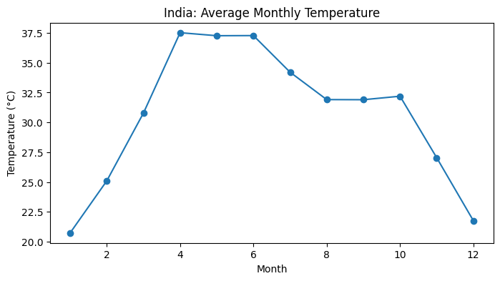
Trend & Seasonality Analysis
Examined long-term trends in weather variables to detect gradual changes over time.
Identified recurring seasonal patterns using time-series decomposition techniques.
Analyzed monthly and yearly variations to understand cyclical behavior.
Insights from trend and seasonality analysis informed the selection of forecasting models.
Page 9

Slide 11

Time Series Analysis
Converted weather data into a time-indexed format for sequential analysis.
Analyzed temporal dependencies, trends, and seasonal components within the data.
Checked stationarity using differencing and statistical tests where required.
Prepared the time series for forecasting using statistical modeling techniques.
Page 10

Slide 12
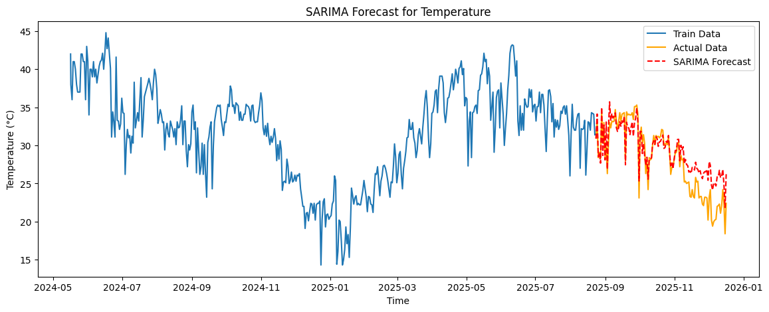
SARIMA MODEL FOR FORECASTING
Parameters:(p=1, d=1, q=1), Seasonal Order: (1,1,1,12)
Explanatory Variables:Wind speed, humidity, precipitation, pressure
Results:Forecasted temperature trends
Visualized train vs. test vs. forecast
Page 11

Slide 13
SARIMA MODEL EVALUATION
Metrics:MAE (Mean Absolute Error): 1.710
RMSE (Root Mean Squared Error): 2.237
Observations:SARIMA performed well but had some deviations
Prophet was chosen for its ability to capture seasonality and trends without requiring extensive parameter tuning
Page 12

Slide 14
PROPHET MODEL FOR FORECASTING
Converted Data to Prophet format (ds, y)
Generated 30-day future forecast
Results Saved: weather_forecast.csv
Prophet Model Visualization
Actual vs Forecasted Temperature Plot
Trends & Seasonality:Captured yearly, weekly, and daily variations
Confidence Intervals Displayed
Model Evaluation:
Metrics:MAE (Mean Absolute Error): 2.345
RMSE (Root Mean Squared Error): 2.955
Comparison with SARIMA:
Prophet captures long-term trends better
SARIMA adapts well to short-term fluctuations
Page 13

Slide 15
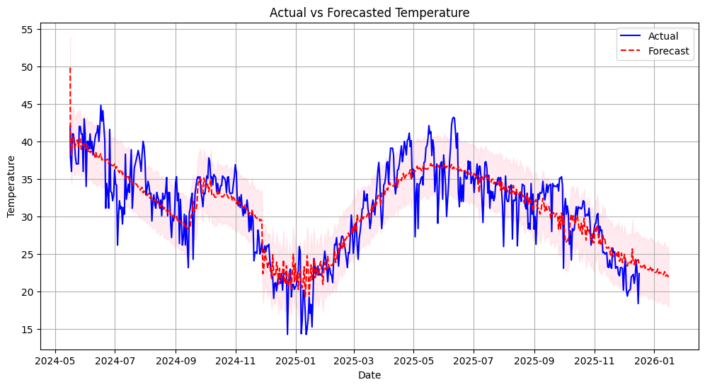

Slide 16
Ensemble Modeling
Approach
Implemented ensemble learning techniques to enhance forecasting accuracy.
Captures complex, non-linear relationships not addressed by traditional time series models.
Model performance evaluated and compared using MAE and RMSE.
Ensemble results complemented statistical forecasting outputs.
Evaluation
Ensemble MAE : 1.921
Ensemble RMSE : 2.274
Page 14

Slide 17
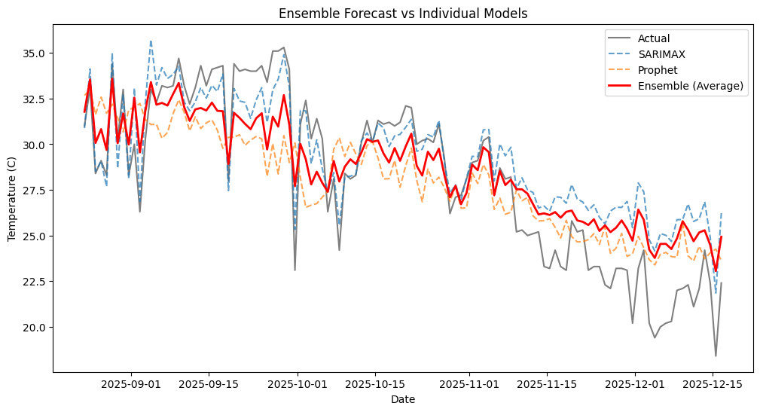

Slide 18
Insights & Observations
Clear long-term trends were observed in key weather variables, indicating gradual changes over time.
Seasonal patterns consistently repeated across years, highlighting strong cyclical behavior.
Time series models effectively captured trend and seasonality, producing stable forecasts.
Forecast accuracy improved after proper data cleaning and stationarity adjustments.
Variations across locations suggest that regional factors significantly influence weather behavior.
Page 15

Slide 19
FUTURE SCOPE
Moving forward, the scope of this project can be significantly expanded to enhance its utility and accuracy. A promising direction is to scale the analysis across multiple countries and regions, capturing localized weather behavior and climate patterns. Incorporating additional meteorological parameters like solar radiation, dew point, and atmospheric pressure could further enrich the predictive capabilities of the models. Integrating satellite data, real-time feeds, and climate change indicators may also open avenues for building a robust and adaptive forecasting system that contributes meaningfully to sustainability efforts and risk mitigation planning.
Page 16

Slide 20
CONCLUSION
This project demonstrated the power of data science in understanding and predicting weather patterns by leveraging historical meteorological data. Through comprehensive preprocessing, exploratory analysis, and time series modeling using SARIMA and Prophet, the study successfully forecasted temperature trends. The SARIMA model performed well in capturing short-term fluctuations, while Prophet proved more effective in modeling long-term seasonal variations. In addition, ensemble techniques were applied to combine predictive strengths, resulting in improved forecasting robustness and overall performance.
Page 18

Slide 21
Thank You
Page 15

